Slide 1
GRASP Patterns
M Taimoor Khan
Taimoor.khan@nu.edu.pk

Slide 2
Patterns
Are not invented. They are harvested from existing solutions.
Are given a name to aid in communications.
Are documented in a rigorous fashion
Sometimes conflict with each other. For example: you apply a patterns to solve one problem, but by doing so, you may introduce others.
– This is called a contradiction, or side-effect.
– These are the tradeoffs designers have to deal with!

Slide 3
GRASP Patterns
Larman introduces a set of basic patterns that he calls GRASP: General Responsibility Assignment Software Pattern
Five GRASP Patterns:
– Information Expert
– Creator
– High Cohesion
– Low Coupling
– Controller

Slide 4
GRASP -Information Expert
Problem : A system will have hundreds of classes. How do I begin to assign responsibilities to them?
Solution : Assign responsibility to the Information Expert–the class that has the information necessary to fulfil the responsibility.
Mechanics :
Step 1: Clearly state the responsibility
Step 2: Look for classes that have the information we need to fulfil the responsibility.
Step 3: Domain Model
Step 4: Sketch out some interaction diagrams.
Step 5: Update the class diagram.

Slide 5
GRASP -Information Expert
Discussion Points:
– Throughout the process of assigning a responsibility, you may discover many lower-level responsibilities
Contradictions:
– Sometimes application of the Expert Pattern is undesirable or may have conflict with other responsibilities

Slide 6
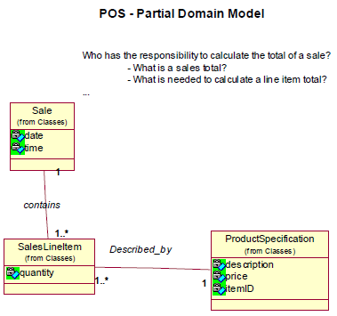
GRASP -Information Expert

Slide 7
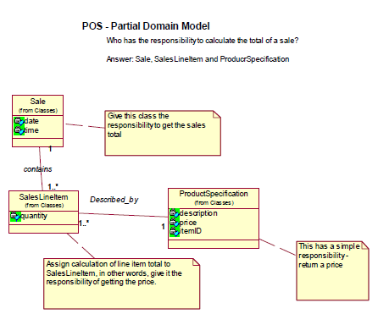
GRASP -Information Expert

Slide 8
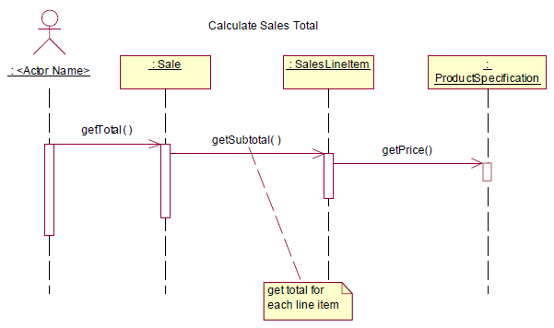
GRASP -Information Expert

Slide 9
GRASP –Creator Pattern
Problem : Who creates new instances of some class?
Solution :
Let class A create an instance of class B if….
A aggregates(whole-part relationship) B objects
A contains B objects
A records instances of B objects
A closely uses B objects
A has initialization data that is needed when creating B objects.
Mechanics:
Step 1: Look at Domain / Design model and ask: “Who should be creating these classes”?
Step 2:Look for classes that create, aggregate, etc.
Step 3:Sketch or update interaction / class diagrams.
Contradictions:
Sometimes it’s time consuming

Slide 10
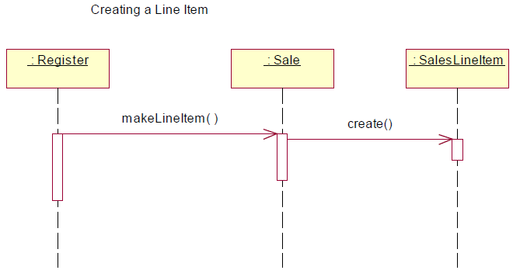
GRASP –Creator Pattern

Slide 11
GRASP –Low Coupling
Concept –Coupling:
Coupling refers to dementedness, or connectedness.
Our goal is to design for low coupling, so that changes in one element (sub-system, system, class, etc.) will limit changes to other elements.
Low coupling supports increased reuse.
Taken to the extreme, what if we were to design a set of classes with no coupling.
We can’t avoid coupling, but we want to make sure we understand the implications of introducing it and/or the tradeoffs of reducing it.

Slide 12
GRASP –Low Coupling
Problem: How do you support low dependency, low change impact, and increased reuse.
Solution: Assign responsibility so responsibility remains low.
Mechanics:
Look for classes with many associations to other classes.
Look for methods that rely on a lot of other methods (or methods in other classes, i.e. dependencies.
Rework your design as needed.

Slide 13
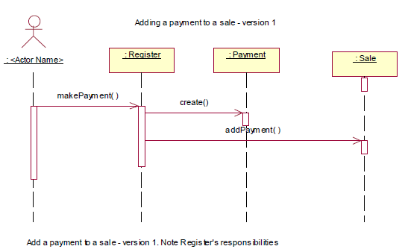
GRASP –Low Coupling

Slide 14
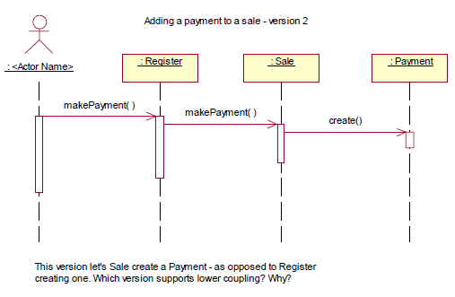
GRASP –Low Coupling

Slide 15
GRASP –High Cohesion
Concept –Cohesion:
Cohesion is a measure of “relatedness”
High Cohesion says elements are strongly related to one another
Low Cohesion says elements are not strongly related to one another
Low Cohesion examples:
System level : ATM with a use case (function) called “Teller Reports”
Class level: A Student class with a method called “getDrivingRecord().
Method level: Methods with the word “And” or “Or” in them.
Also applies to subsystem (package) level, component level, etc.
–Designs with low cohesion are difficult to maintain and reuse.
–One of the fundamental goals of an effective design is to achieve high cohesion with low coupling

Slide 16
GRASP –High Cohesion
Problem: How do you keep complexity manageable?
Solution : Assign responsibility so that cohesion remains high.
Mechanics : Look for classes with too-few or disconnected methods.
Look for methods that do too much (hint: method name)
Rework your design as needed.
Contradictions:
High Cohesion and low coupling are competing forces.

Slide 17
GRASP –High Cohesion
Additional:
Larman describes degrees of cohesion, from very low to high. For now, just consider that in general, classes with a small number of functionally related methods is more desirables than bloated classes with disconnected methods.
Look at the sequence diagrams for adding a payment to a sale, but this time from the perspective of cohesion. Which version supports high cohesion, and why?
This example illustrates that:
High cohesion and low coupling can be competing forces.
Design is not so clear cut, e.g. it is not always an exact science

Slide 18
GRASP -Controller
Problem: Who handles events from external actors, e.g. startup(), playSongs(), etc?
Solution: Assign the responsibility to a controller class, such as:
A class that represents the overall system, device, or subsystem. Example: Jukebox.
A class that represents a use case. Example: makeSaleHandler. makeSaleCoordinator, etc.
These classes often don’t do the work, but delegate it to others.
Additional:
The decision to create system controllers vs. use case controllers are often driven by the dynamics of high cohesion vs. low coupling.

Slide 19
GRASP –Controller
Additional :
Watch for bloated controllers.
From an architectural perspective, systems are usually broken upon to layers, or tiers. Example 2 tier client-server, 3 tier, n tier, etc.
The UI objects are in the presentation layer.
The business objects representing the problem domain are in the application or domain layer.
The objects representing databases, network connections, etc. are in the Technical or infrastructure layer(s)
Layering and related decisions are frequently made by an Architect.
Controllers typically receive requests from UI (interface objects). It is not a good idea to put business logic in UI objects

Slide 20
Assigning Responsibilities –Other Sources
CRC Cards:
–Another popular technique to assigning responsibilities to classes is to use CRC cards CRC = Class: Responsibility: Collaboration
–Introduced by Kent Beck and Ward Cunnigham

